Slide 1
An Introduction to Safeguarding
For the leaders of Traditional Youth Marching Bands
Prepared using information taken from www.nspcc.org.uk

Slide 2
The purpose of this presentation
DISCLAIMER:
This Introduction to Safeguarding has been put together using information from various sources including Government guidance and the NSPCC.
It is designed to introduce Safeguarding to band leaders of member bands of the Traditional Youth Marching Band Association and to offer them guidance on what policies and practices should be in place.
It does not intend to replace accredited training provided by online companies/charities and as such, we advise all band leaders to regularly review and update their knowledge, policies and safeguarding practices within their own bands.

Slide 3
Aims
By the end of this presentation you will have had an introduction to Safeguarding children and young people including the following topics:
What is Safeguarding?
The different types of abuse
FGM
Peer on peer abuse
What to do if a child makes a disclosure
What do Youth Marching Bands need to have in place
Safeguarding Policy
Safeguarding training

Slide 4
What is Safeguarding?
Safeguarding is the term used in the UK to denote measures to protect the health, well-being and human rights of individuals which allow – especially children – to live free from abuse, harm and neglect.
Safeguarding training has been a legal requirement for professionals that come into regular contact with children and young people for many years.
Any child can be considered at risk of harm or abuse regardless of their age, ethnicity, gender or religion.
The UK government has enacted legislation and published guidance to protect children under the Children’s Act of 2004.
Safeguarding is EVERYONE’S responsibility.

Slide 5
What are the different types of abuse?
In children;
Physical
Sexual
Emotional/psychological
Neglect
In adults, the above and;
Financial/economic
Cultural/identity

Slide 6
Physical Abuse
Physical abuse is when someone intentionally hurts or harms a child or young person. It can include:
hitting with hands or objects
slapping and punching
kicking
shaking
throwing
poisoning
burning and scalding
biting and scratching
breaking bones
drowning.

Slide 7
Signs of Physical Abuse
Bumps and bruises don't always mean a child is being physically abused. All children have accidents, trips and falls. And there isn't just one sign or symptom to look out for. But it's important to be aware of the signs.
If a child regularly has injuries, there seems to be a pattern to the injuries or the explanation doesn't match the injuries, then this should be reported.
Physical abuse symptoms include:
bruises
broken or fractured bones
burns or scalds
scratches
bite marks.

Slide 8
Physical abuse can also include other injuries and health problems, such as:
scarring
the effects of poisoning, such as vomiting, drowsiness or seizures
breathing problems from drowning, suffocation or poisoning.
Head injuries in babies and toddlers can be signs of abuse so it's important to be aware of these. Visible signs include:
swelling
bruising
fractures
being extremely sleepy or unconscious
breathing problems
seizures
vomiting
unusual behaviour, such as being irritable or not feeding properly.

Slide 9
Sexual Abuse
Sexual abuse can happen anywhere – and it can happen in person or online.
When a child or young person is sexually abused, they're forced or tricked into sexual activities.
They might not understand that what's happening is abuse or that it's wrong. And they might be afraid to tell someone.

Slide 10
Types of Sexual Abuse
There are 2 types of sexual abuse – contact and non-contact abuse. And sexual abuse can happen in person or online.
Contact abuse is where an abuser makes physical contact with a child. This includes:
sexual touching of any part of a child's body, whether they're clothed or not
using a body part or object to rape or penetrate a child
forcing a child to take part in sexual activities
making a child undress or touch someone else.
Contact abuse can include touching, kissing and oral sex – sexual abuse isn't just penetrative.
Non-contact abuse is where a child is abused without being touched by the abuser. This can be in person or online and includes:
exposing or flashing
showing pornography
exposing a child to sexual acts
making them masturbate
forcing a child to make, view or share child abuse images or videos
making, viewing or distributing child abuse images or videos
forcing a child to take part in sexual activities or conversations online or through a smartphone.

Slide 11
Signs of Sexual Abuse
Knowing the signs of sexual abuse can help give a voice to children. Sometimes children won't understand that what's happening to them is wrong. Or they might be scared to speak out. Some of the signs you might notice include:
Avoiding being alone with or frightened of people or a person they know.
Language or sexual behaviour you wouldn't expect them to know.
Having nightmares or bed-wetting.
Alcohol or drug misuse.
Self-harm.
Changes in eating habits or developing an eating problem.
Bruises.
Bleeding, discharge, pains or soreness in their genital or anal area.
Sexually transmitted infections.
Pregnancy.

Slide 12
If a child is being or has been sexually abused online, they might:
spend a lot more or a lot less time than usual online, texting, gaming or using social media
seem distant, upset or angry after using the internet or texting
be secretive about who they're talking to and what they're doing online or on their mobile phone
have lots of new phone numbers, texts or email addresses on their mobile phone, laptop or tablet.
Children and young people might also drop hints and clues about the abuse.

Slide 13
Emotional Abuse
Emotional abuse is any type of abuse that involves the continual emotional mistreatment of a child. It's sometimes called psychological abuse.
Emotional abuse can involve deliberately trying to scare, humiliate, isolate or ignore a child.
Emotional abuse is often a part of other kinds of abuse, which means it can be difficult to spot the signs or tell the difference, though it can also happen on its own.

Slide 14
Types of Emotional Abuse
Emotional abuse includes:
humiliating or constantly criticising a child
threatening, shouting at a child or calling them names
making the child the subject of jokes, or using sarcasm to hurt a child
blaming and scapegoating
making a child perform degrading acts
not recognising a child's own individuality or trying to control their lives
pushing a child too hard or not recognising their limitations
exposing a child to upsetting events or situations, like domestic abuse or drug taking
failing to promote a child's social development
not allowing them to have friends
persistently ignoring them
being absent
manipulating a child
never saying anything kind, expressing positive feelings or congratulating a child on successes
never showing any emotions in interactions with a child, also known as emotional neglect.

Slide 15
Signs of Emotional Abuse
There might not be any obvious physical signs of emotional abuse or neglect. And a child might not tell anyone what's happening until they reach a 'crisis point'. That's why it's important to look out for signs in how a child is acting.
As children grow up, their emotions change. This means it can be difficult to tell if they're being emotionally abused. But children who are being emotionally abused might:
seem unconfident or lack self-assurance
struggle to control their emotions
have difficulty making or maintaining relationships
act in a way that's inappropriate for their age.
The signs of emotional abuse can also be different for children at different ages.

Slide 16
Neglect
Neglect is the ongoing failure to meet a child's basic needs and the most common form of child abuse.
A child might be left hungry or dirty, or without proper clothing, shelter, supervision or health care. This can put children and young people in danger. And it can also have long term effects on their physical and mental wellbeing.

Slide 17
Types of Neglect
Neglect can be a lot of different things, which can make it hard to spot. But broadly speaking, there are 4 types of neglect.
Physical neglect A child's basic needs, such as food, clothing or shelter, are not met or they aren't properly supervised or kept safe.
Educational neglect A parent doesn't ensure their child is given an education.
Emotional neglect A child doesn't get the nurture and stimulation they need. This could be through ignoring, humiliating, intimidating or isolating them.
Medical neglect A child isn't given proper health care. This includes dental care and refusing or ignoring medical recommendations.

Slide 18
Signs of Neglect
Neglect can be really difficult to spot. Having one of the signs doesn't necessarily mean a child is being neglected. But if you notice multiple signs that last for a while, they might show there's a serious problem. Children and young people who are neglected might have:
Poor appearance and hygiene: being smelly or dirty, being hungry or not given money for food, having unwashed clothes, not having the correct clothes (e.g. not having a coat in winter), having repeated nappy rash in infants.
Health and development problems: anaemia, body issues, such as poor muscle tone or prominent joints, medical or dental issues, missed medical appointments, such as for vaccinations, not given the correct medicines, poor language or social skills, regular illness or infections, repeated accidental injuries, often caused by lack of supervision, skin issues, such as sores, rashes, flea bites, scabies or ringworm, thin or swollen tummy, tiredness, untreated injuries, weight or growth issues.
Housing and family issues: living in an unsuitable home environment, such as having no heating, being left alone for a long time, taking on the role of carer for other family members.
Changes in behaviour: becoming clingy, becoming aggressive, being withdrawn, depressed or anxious, changes in eating habits, displaying obsessive behaviour, finding it hard to concentrate or take part in activities, missing school, showing signs of self-harm, using drugs or alcohol.

Slide 19
FGM
Female Genital Mutation.
FGM is illegal in the United Kingdom under the Prohibition of Female Circumcision, 1985.
There is a legal requirement to report suspected cases to the Police.
FGM abuse is most common in girls of African heritage.
Look out for girls of colour going on unexpected holidays or going on a ‘special trip’ to areas of Africa in particular.
Register for a free, certified FGM course at virtual-college.co.uk.

Slide 20
Peer on Peer abuse
Peer on Peer abuse can take the form of physical , sexual abuse, harassment, violence, bullying, emotional harm and can be on or off line.
Peer on Peer abuse can include up skirting – the taking of photographs from below, up a skirt.
It can include grooming for sexual and criminal exploitation.
Peer on a Peer abuse often goes on unseen.
Concerns should be taken seriously and any peer on peer abuse that involves sexual assault must result in a multi-agency response.

Slide 21
County Lines
County lines is the organised criminal distribution of drugs from the big cities into smaller towns and rural areas using children and vulnerable people. Although cannabis is occasionally linked to the county lines organisations, it is harder drugs that provide the focus: heroin, cocaine, and amphetamines.
The main county line gangs operate from London and Liverpool, but other groups work out of Reading, Birmingham, and Manchester. Faces from the cities are not known by police in the quieter areas and can operate more easily. At least for a time.
The influence of county lines is nationwide. Metropolitan Police have found gang members from Islington in 14 different police areas. Boys, typically 15 and 16, but sometimes younger, travel by coach, train, and taxi into rural or coastal area, with only a ‘burner’, or disposable phone, often stolen, and a stash of drugs. For the gang’s security each runner only knows one other phone number along the delivery chain.
The drug runner needs a place to stay and to do this the gang will take over the home of a vulnerable person, often after following them home. This is known as “cuckooing”. Once in the property, drugs and weapons can be stored there along with a possible venue for dealing drugs and the sexual exploitation of girls and young women.
(www.safeguardinginschools.com)

Slide 22
What to do if a child makes a disclosure
listen carefully to what they're saying
let them know they've done the right thing by telling you
tell them it's not their fault
say you'll take them seriously
don't confront the alleged abuser
explain what you'll do next
report what the child has told you as soon as possible.

Slide 23
What do Youth Marching Bands need to have in place?
Traditional style youth marching bands fall beneath more than one umbrella body. Therefore, ‘one size fits all’ advice on good safeguarding practice doesn’t necessarily work.
Scout and Guide bands, Boys and Girls Bridge bands and other such uniformed organisation bands need to follow the guidelines of their governing body.
Independent bands have no such governing body, unless they have formed close links with their Local Authority. As a result, the band leaders of independent bands need to ensure that they have the relevant documents in place.
The Traditional Youth Marching Band Association has provided a guidance document called ‘Keeping Band Members and Staff Safe’ to assist bands with the provision of appropriate safeguarding practice.

Slide 24
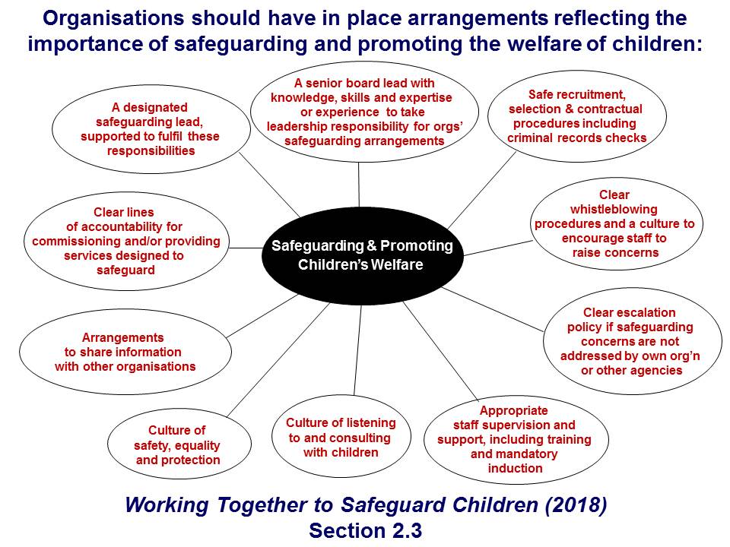

Slide 25
All bands should have a Safeguarding policy that covers the following…
A senior board lead with experience – each band should be encouraged to have someone with experience and training in safeguarding on their board/committee/leadership team. They should keep themselves up to date with latest government safeguarding information.
A Designated Safeguarding Lead – as specified by the Children’s Act of 2004 someone with this role takes all responsibility for Safeguarding and Child Protection (including online safeguarding) for the group.
Safe recruitment – make sure all instructors are over the age of 18 and are DBS checked by the band or governing organisation. DBS checks are not portable and can not be carried over from one organisation to another. Those that sign up to the update service are able to update their details, this does not mean they are transferable.
Clear lines for accountability – everybody within the band should know who to report concerns to. Including if those concerns are about one of the leaders of the band.
Clear whistleblowing procedures – whistleblowing is the reporting of suspected misconduct within the band. Bands must encourage a culture where wrong doing can be addressed quickly. Having a whistleblowing policy reinforces to staff the importance of their duty to safeguarding and how it is everyone’s responsibility.
Arrangements to share information with other organisations – everyone should know who to report concerns to within the band and should be able to access telephone numbers of the Local Authority, MASH team, or NSPCC.
Appropriate staff supervision and support – every bands must ensure that their instructors are over the age of 18 and DBS checked. Where there are members of the band, under the age of 18, assisting with training they should be supervised appropriately by adult staff members.
Culture of safety – the band should have have set structures in place that allow for safe practice, such as dismissal of young members to parents, chaperones on parades, never leaving children alone, never leaving adults alone on a 1:1 basis etc.
Culture of listening – children have the right to be heard. Encouraging a culture of listening to children that have concerns allows children to feel safe and able to disclose should they need to.

Slide 26
Safeguarding training
It is essential for youth bands to ensure their leaders and instructors are aware of Safeguarding. Training them at Level One or Two would be good practice.
Courses are available online for as little as £20 per course at www.virtual-college-college.co.uk.
There is an accredited course specifically designed for music groups childprotectioncompany.com.
In schools, the Designated Safeguarding Lead would be expected to have completed Level Three training.
Instructors within a band should receive regular training from the Designated Safeguarding Lead, or Senior Board Member with experience.
The Safeguarding Policy should be reviewed annually and kept up to date with government updates.

Slide 27
Links
Safeguarding Training for Music Groups childprotectioncompany.com.
UK Government website www.gov.uk
Virtual college www.virtual-college.co.uk
NSPCC www.nspcc.org
NSPCC Introduction to Safeguarding – A Guide for the Voluntary Sector.
NSPCC Writing a Safeguarding Policy.
Children’s Act 2004
Working together to safeguard children gov.uk.
Voluntary Safeguarding Code of Conduct.
Information sharing gov.uk.
Free certified FGM course at virtual-college.co.uk.

